Slide 1
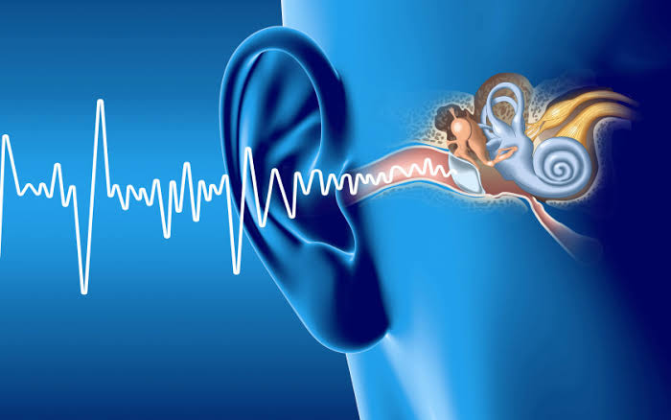
DEAFNESS
RACHANA SHRIVASTAVA
B Sc NURSING 5th SEMESTER

Slide 2
content :
Definition
Types
Severity of hearing loss
Causes
Risk factor
Pathophysiology
Clinical manifestation
Diagnostic evaluation
Prevention and control
Management
Complication

Slide 3
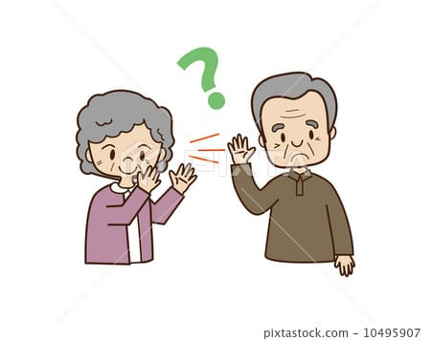
DEFINITION
Loss of hearing in one or both ears ( partial or total ) is called deafness
OR
Deafness is defined in medical contexts as hearing loss that prevents a person from understanding spoken language , an audiological condition.

Slide 4
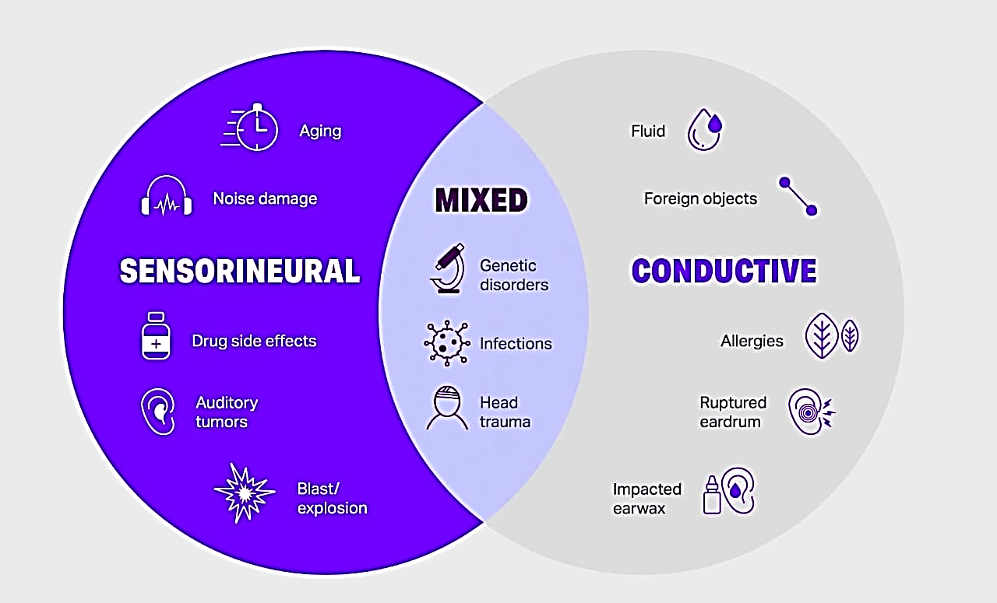
TYPES
CONDUCTIVE HEARING LOSS.
SENSORINEURAL HEARING LOSS.
MIXED HEARING LOSS.

Slide 5
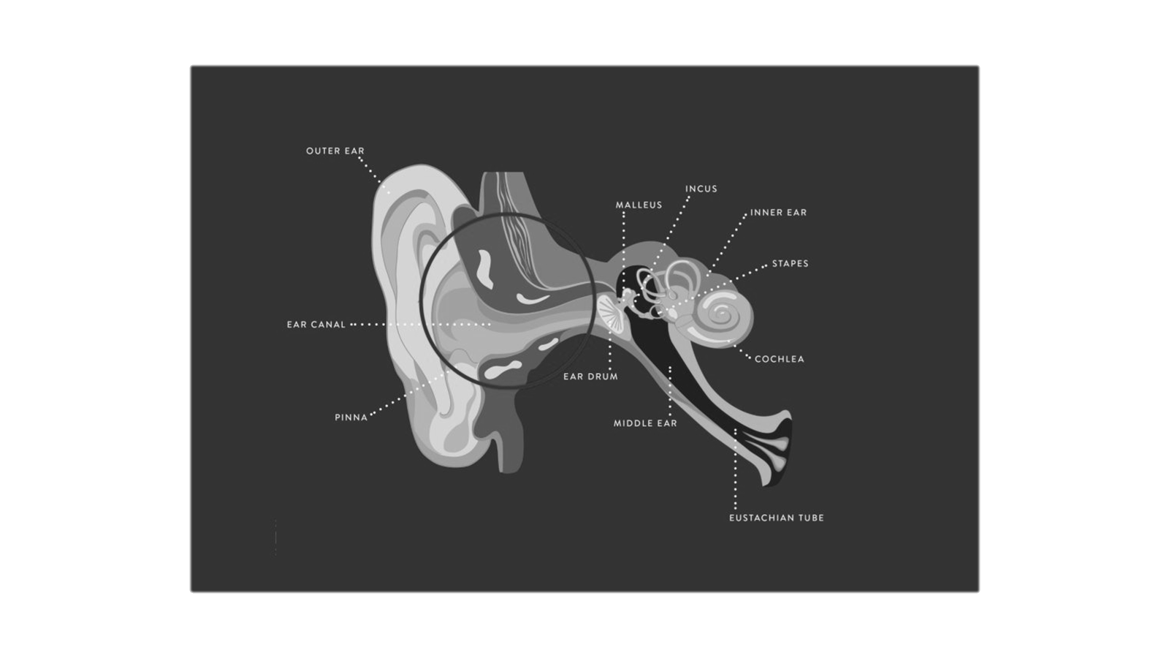
CONDUCTIVE HEARING LOSS
When sound are unable to pass from external ear to internal ear , this is caused by conductive loss.

Slide 6
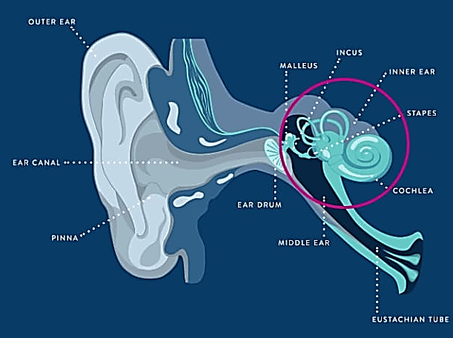
Sensorineural hearing loss
Loss of hearing involving the cochlea and auditory ( hearing ) nerve.

Slide 7
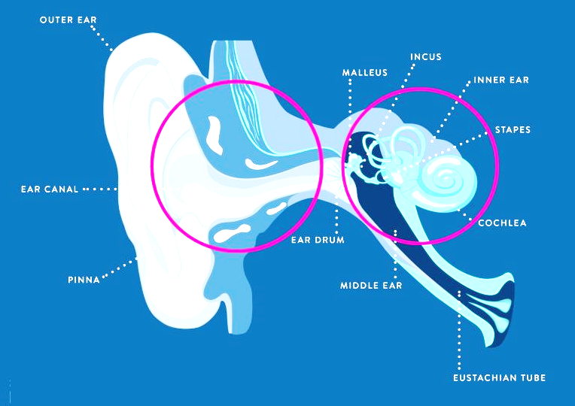
Mixed hearing loss
A sensorineural and conductive hearing loss occurring together.

Slide 8
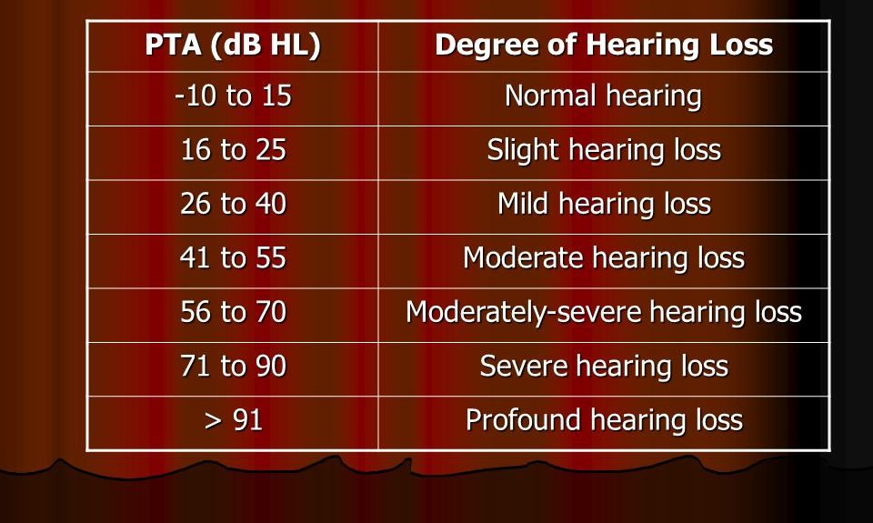
Severity of hearing loss

Slide 9






etiology / causes
Age.
Congenital .
Exposure to loud noise.
Head injury.
Ototoxic drugs.
Illness.
Illness
Age
Congenital
Ototoxic drugs
Head injury
Exposure to loud noise

Slide 10
Risk factor
Family history of sensorineural impairment.
Congenital malformation of the cranial structure ( ear ).
Use of ototoxic medication ( eg : gentamycin ).
Recurrent ear infection
bacterial Meningitis
Chronic exposure to loud noise.
Perforation of the tympanic membrane.

Slide 11
pathophysiology
Disorders of external or middle ear
Interruption in the transmission of sound by air to the inner ear
Conductive deafness
Disorders of inner ear or vestibulocochlear nerve or aging
Interruption in neural transmission of sound to brain
Sensorineural deafness

Slide 12
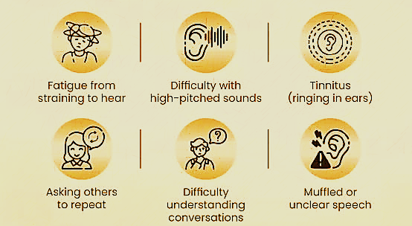
Clinical manifestations

Slide 13
Diagnostic evaluation
History collection
Physical examination
Rinne's test
Weber test
Audiometry
Tympanometry
Imaging test
CT Scan
MRI ( Magnetic resonance
imaging )

Slide 14
Prevention and control
Avoid loud noises .
Avoid sticking objects in your ears .
Regular check – ups problems .
Treat ear infection to prevent hearing damage .
Avoid ototoxic substance ( medicine and ototoxic chemicals ) .
Use hearing aid .
Communication strategies – sign language , writing notes .
Assistive devices – alerting device , FM system .

Slide 15
Management
MEDICAL MANAGEMENT :
Restore hearing –
Antibiotics drugs : to treat infection .
Steroid drugs : to treat inflammation .
Remove impacted wax and foreign bodies .
Assist hearing -
Hearing aids – Hearing aids is designed to amplify sound .
Sign language – It involves hand shape , movement of hand
arms , body and facial expression .

Slide 16
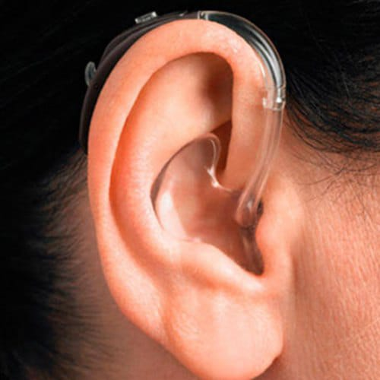
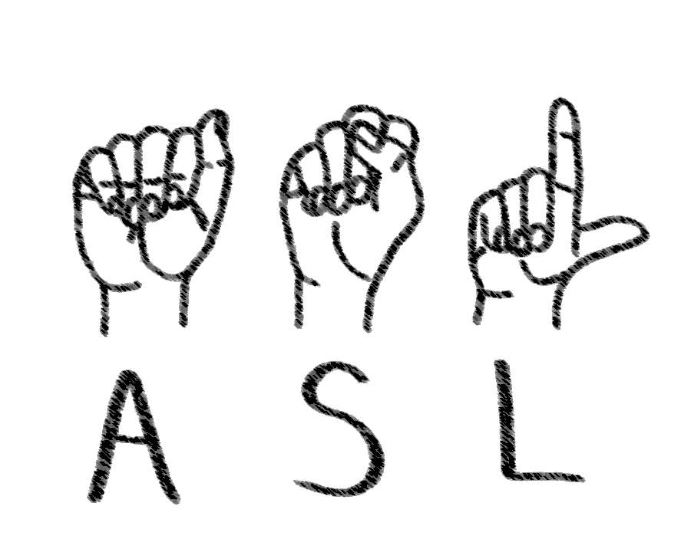
HEARING AID
SIGN LANGUAGE

Slide 17
SURGICAL MANAGEMENT :
Surgery is indicated for conductive or mixed hearing loss .
To restore conductive hearing .
- Myringotomy
Assisted hearing in profound deafness Cochlear implants .
- Middle ear implants ( semi – implantable hearing device ) .
Tumour excision for acoustic neuroma .

Slide 18
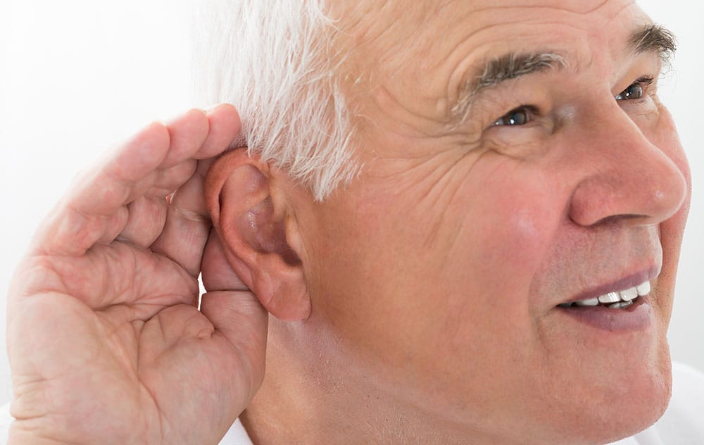
complication
Inability to hear .
Nerve damage .
Presbycusis ( disorder in the inner ear ).
Brain atrophy ( loss of brain cells and there connection ) .
Difficulty communicating .
Increase risk of falls .

Slide 19


Slide 20


